Slide 1

Tuberculosis around the world 1990 - 2013
Melissa Nielsen​

Slide 2

objective
INVESTIGATE WORLDWIDE TUBERCULOSIS DATA (1990 – 2013) TO UNDERSTAND which COUNTRIES WHICH HAVE IMPROVED tuberculosis STATISTICS
use to inform public health research for tuberculosis best practices

Slide 3

Questions
1. How has tuberculosis changed AROUND THE WORLD over time?
2. In Which Countries has tuberculosis improved?
REDUCED DEATH RATES
REDUCED CASES
IMPROVED CASE DETECTION

Slide 4

DATA OVERVIEW
1990 – 2013
Tuberculosis stats for every country, including:
Prevalence
Deaths
Incidence
Case detection rate

Slide 5
DATA OVERVIEW
All stats are presented by in cases/100K population and overall
All stats are presented by cases without HIV-positivity and cases with HIV-positivity
Prevalence vs Incidence
Prevalence – number of cases during a given time period
Changes when people are cured or die
Incidence – number of new cases in a given time period

Slide 6
DASHBOARD #1
Global Tuberculosis Trends 1990 - 2013

Slide 7
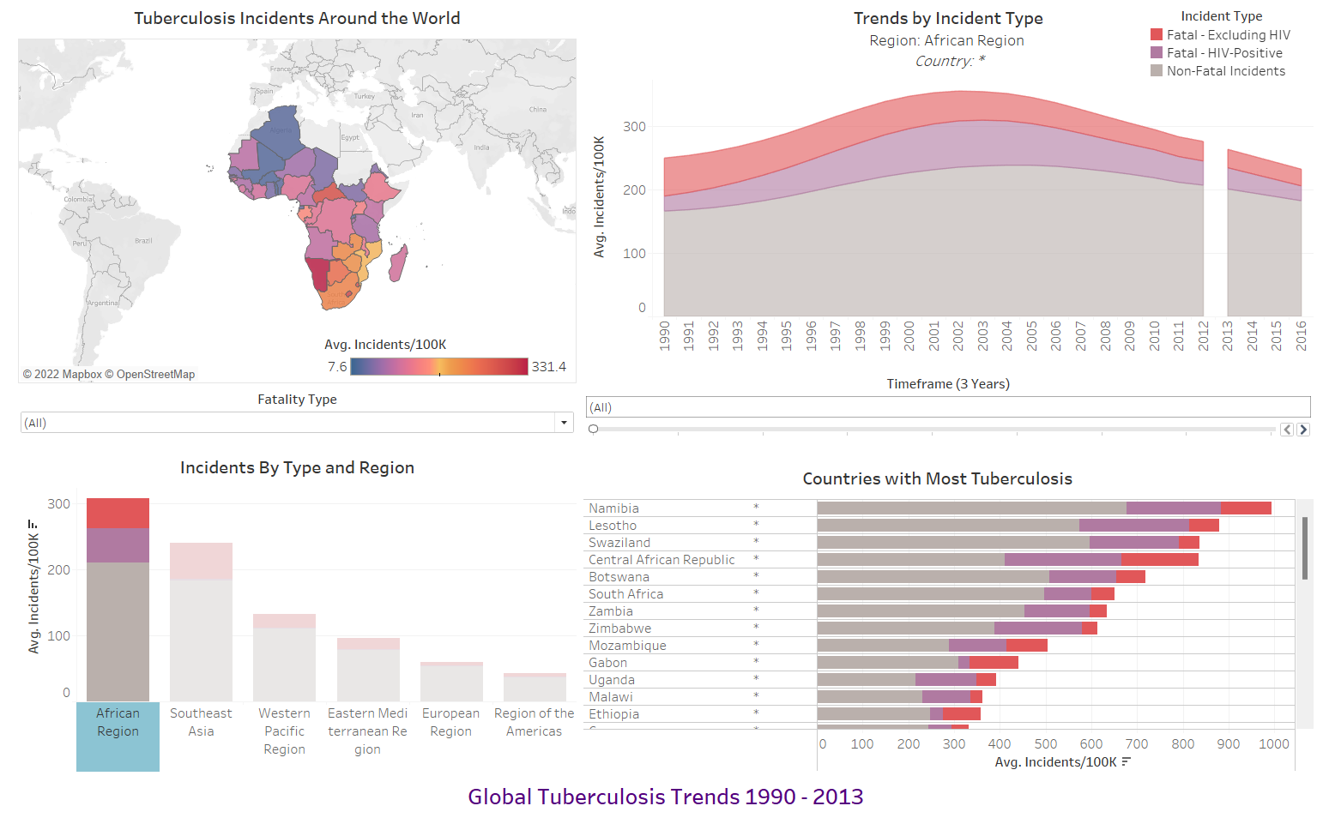
Map zooms into selected region. Map is clickable and acts as filter.
Title and chart both change depending which region or country are selected
Filter for HIV or non-HIV fatalities
Can filter by year using slide filter (3 year groups for simplicity)
Region and incident type (non-fatal, fatal-HIV, fatal-non-HIV) are clickable and create a filter for all other charts in dashboard
List of countries changes based on selected region. List is clickable to filter by country.
Can click ‘African Region’ to filter for all African incidents, or one section of stacked bar chart to look at only specific incident type.

Slide 8
DASHBOARD #2
Measurement Estimation Methods

Slide 9
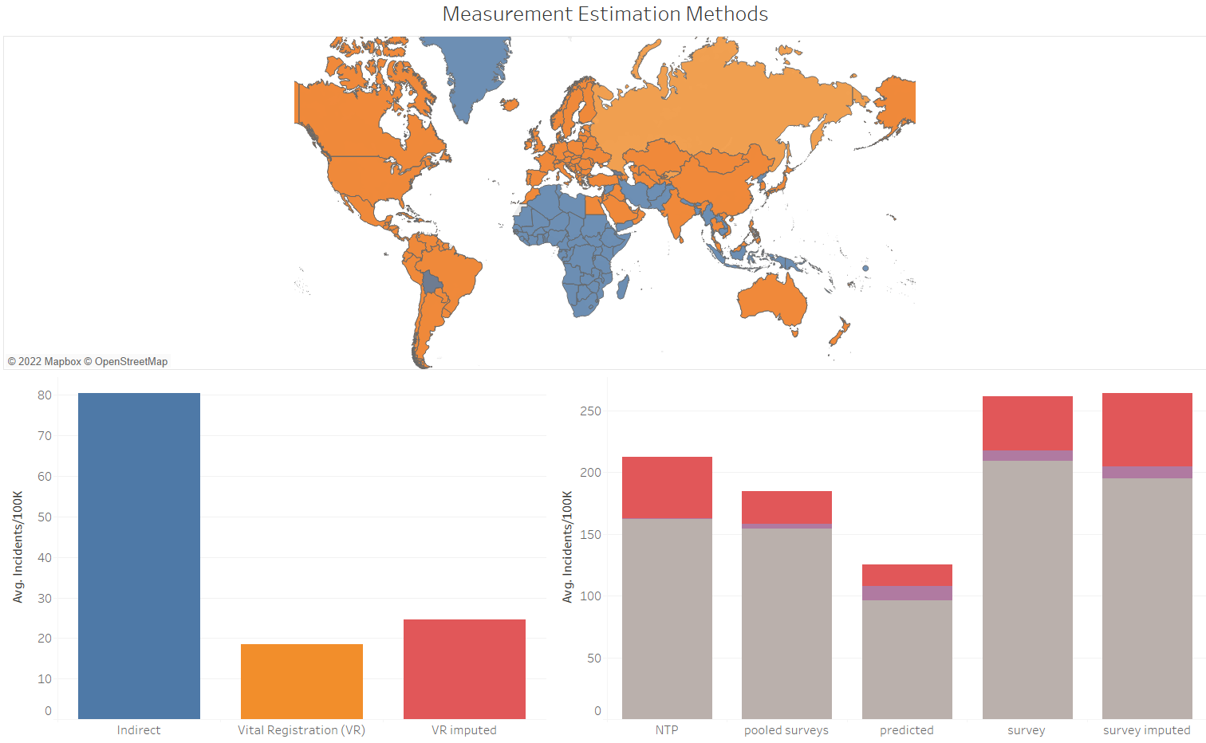
Interested to see measurement types around the world, and how they corresponded to region.
DASHBOARD #2
Measurement Estimation Methods
Both work as filters for map above.

Slide 10
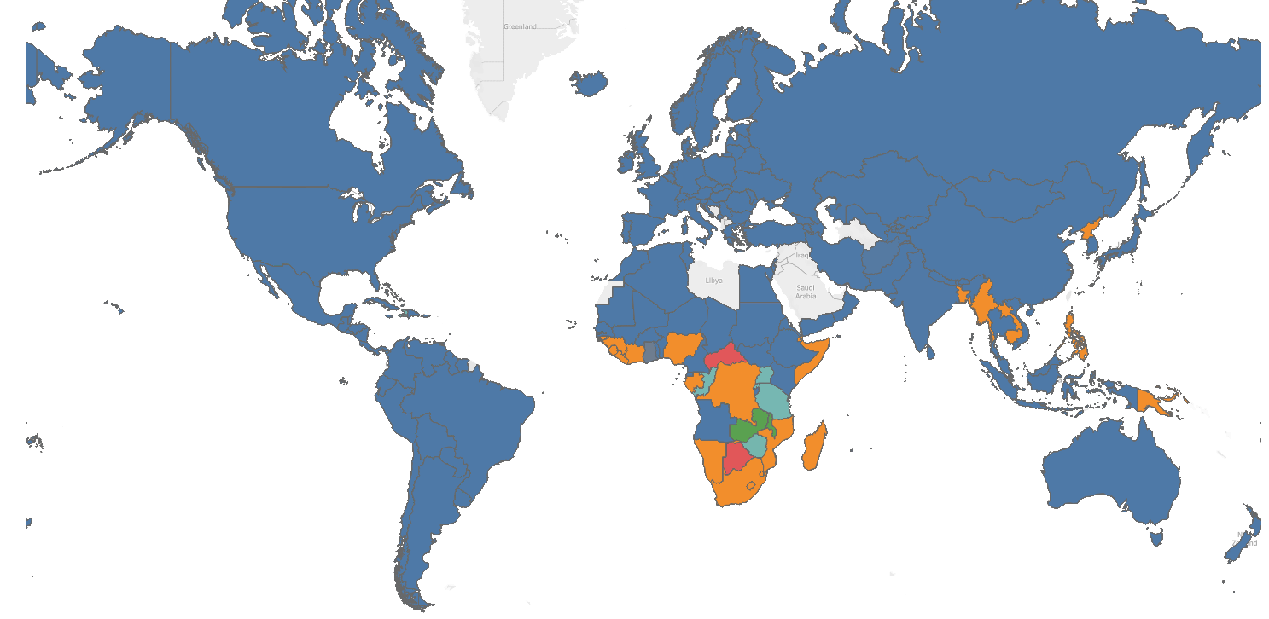
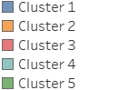
Cluster Analysis
Attribute | Cluster 1 | Cluster 2 | Cluster 3 | Cluster 4 | Cluster 5
Number of Items | 6761 | 1821 | 322 | 1397 | 634
Avg. Estimated total population number | 39,112,000 | 79,100,000 | 9,605,300 | 13,154,000 | 13,828,000
Avg. Number of Incidents/100K Population | 19 | 101 | 253 | 47 | 224
Sum of Estimated HIV in incident TB (percent) | 3.8 | 5.0 | 16.4 | 29 | 64
Sum of Estimated prevalence of TB (all forms) per 100 000 population | 91.2 | 522 | 1246 | 203 | 520
Sum of Estimated mortality of TB cases (all forms, excluding HIV) per 100 000 population | 6.8 | 63.5 | 152.2 | 24.4 | 47.8
 | Countries with low rates of tuberculosis | Countries with high tuberculosis and low HIV | Countries with high rates of tuberculosis | Medium tuberculosis, medium HIV | Countries with high rates of HIV

Slide 11

Key Learnings (about tableau!)
Data needs to be set up as unpivoted
Unpivoted table separately and joined with existing data
Helpful to have unrelated variable to make comparisons –e.g., having GDP would have been helpful
LOD Statements and order of filtering is critical to get the result you want!

Slide 12
Key Learnings (about TUBERCULOSIS)
Between 1990 and 2013, tuberculosis cases in Africa surpasses those in Southeast Asia
From 1993 onwards, tuberculosis rates have been significantly higher in the African Region than elsewhere
Many tuberculosis deaths in Africa are associated with HIV-positivity, this is uncommon elsewhere

Slide 13
Key Learnings (about TUBERCULOSIS)
Djibouti, Namibia, Uganda, and South Africa are all consistently in the top 5 countries with the most tuberculosis
Cambodia is the only country outside of the African Region which consistently is in the top 5 countries with the most tuberculosis

